Slide 1




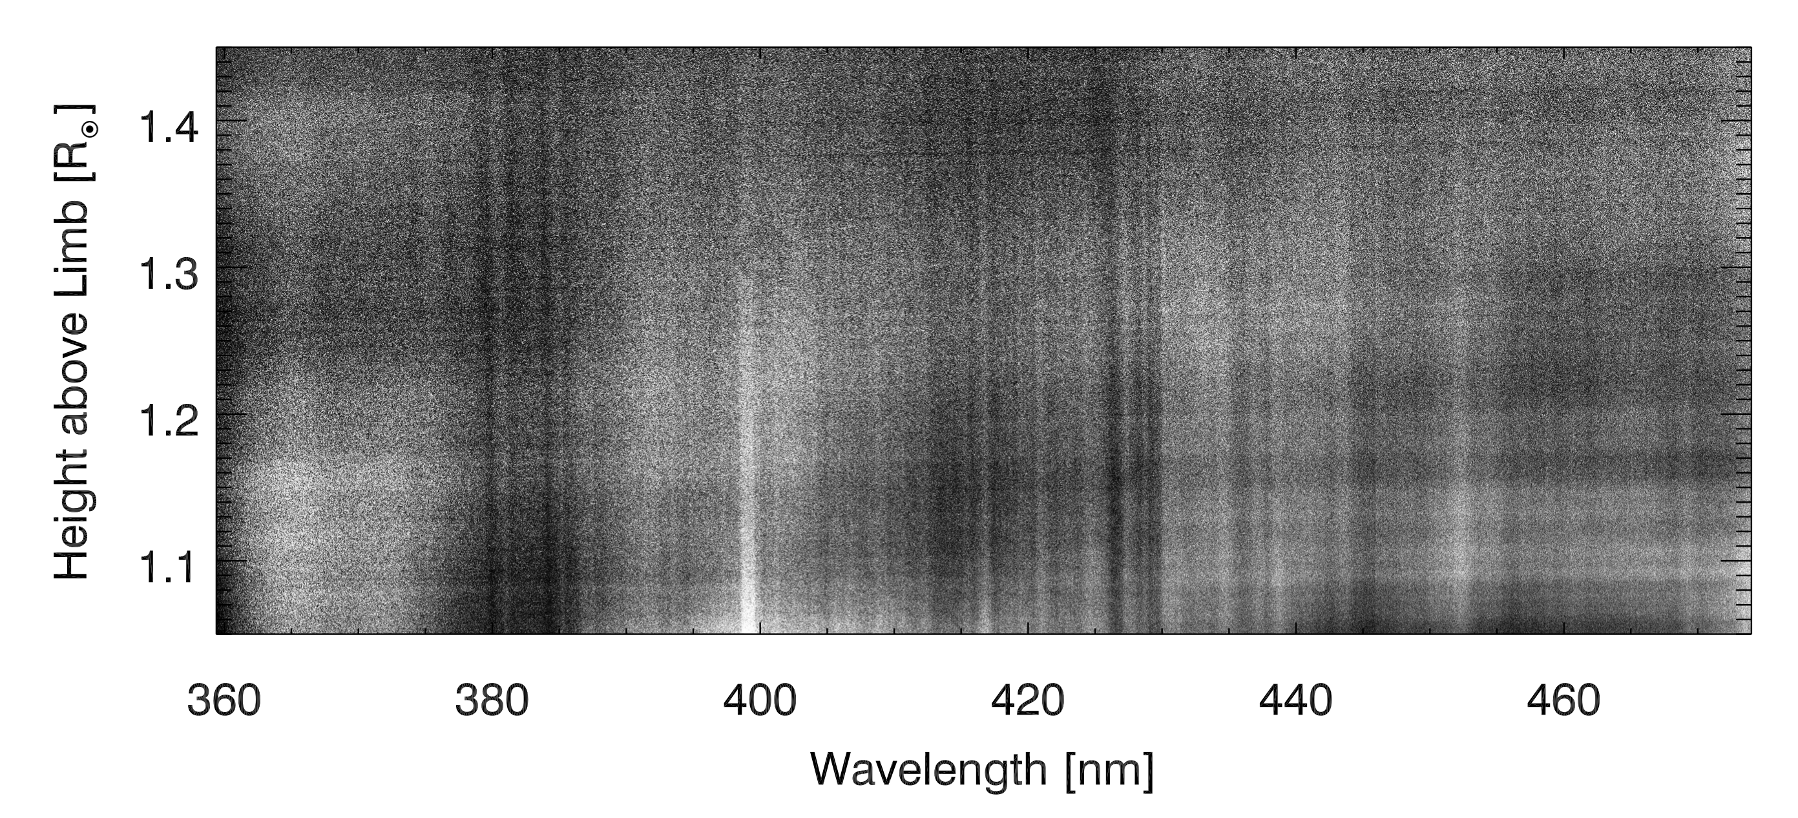
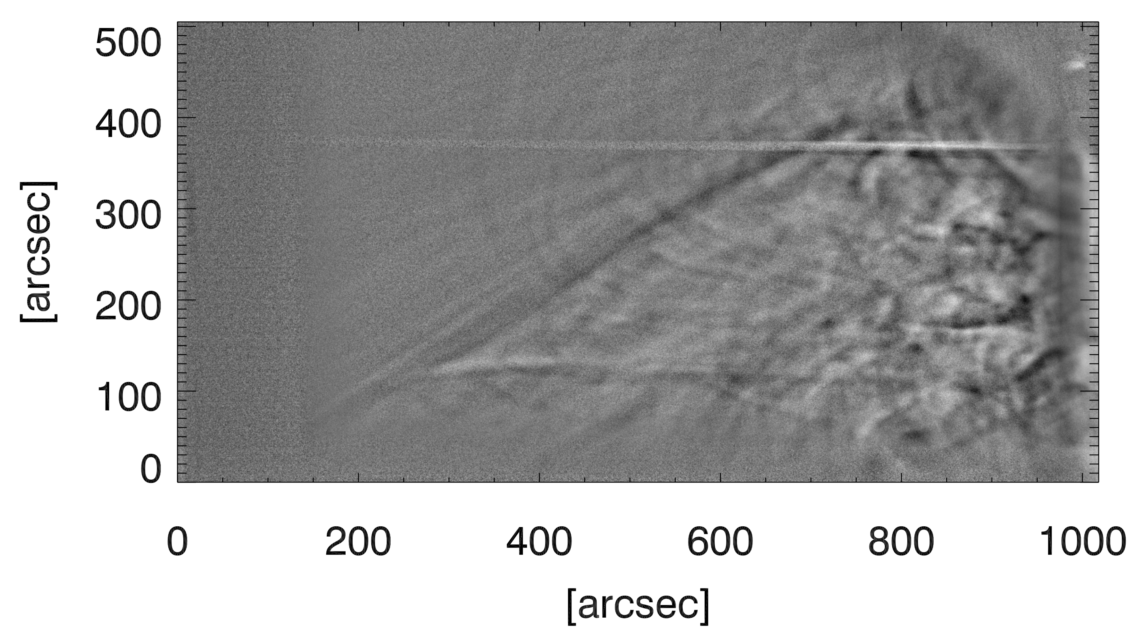
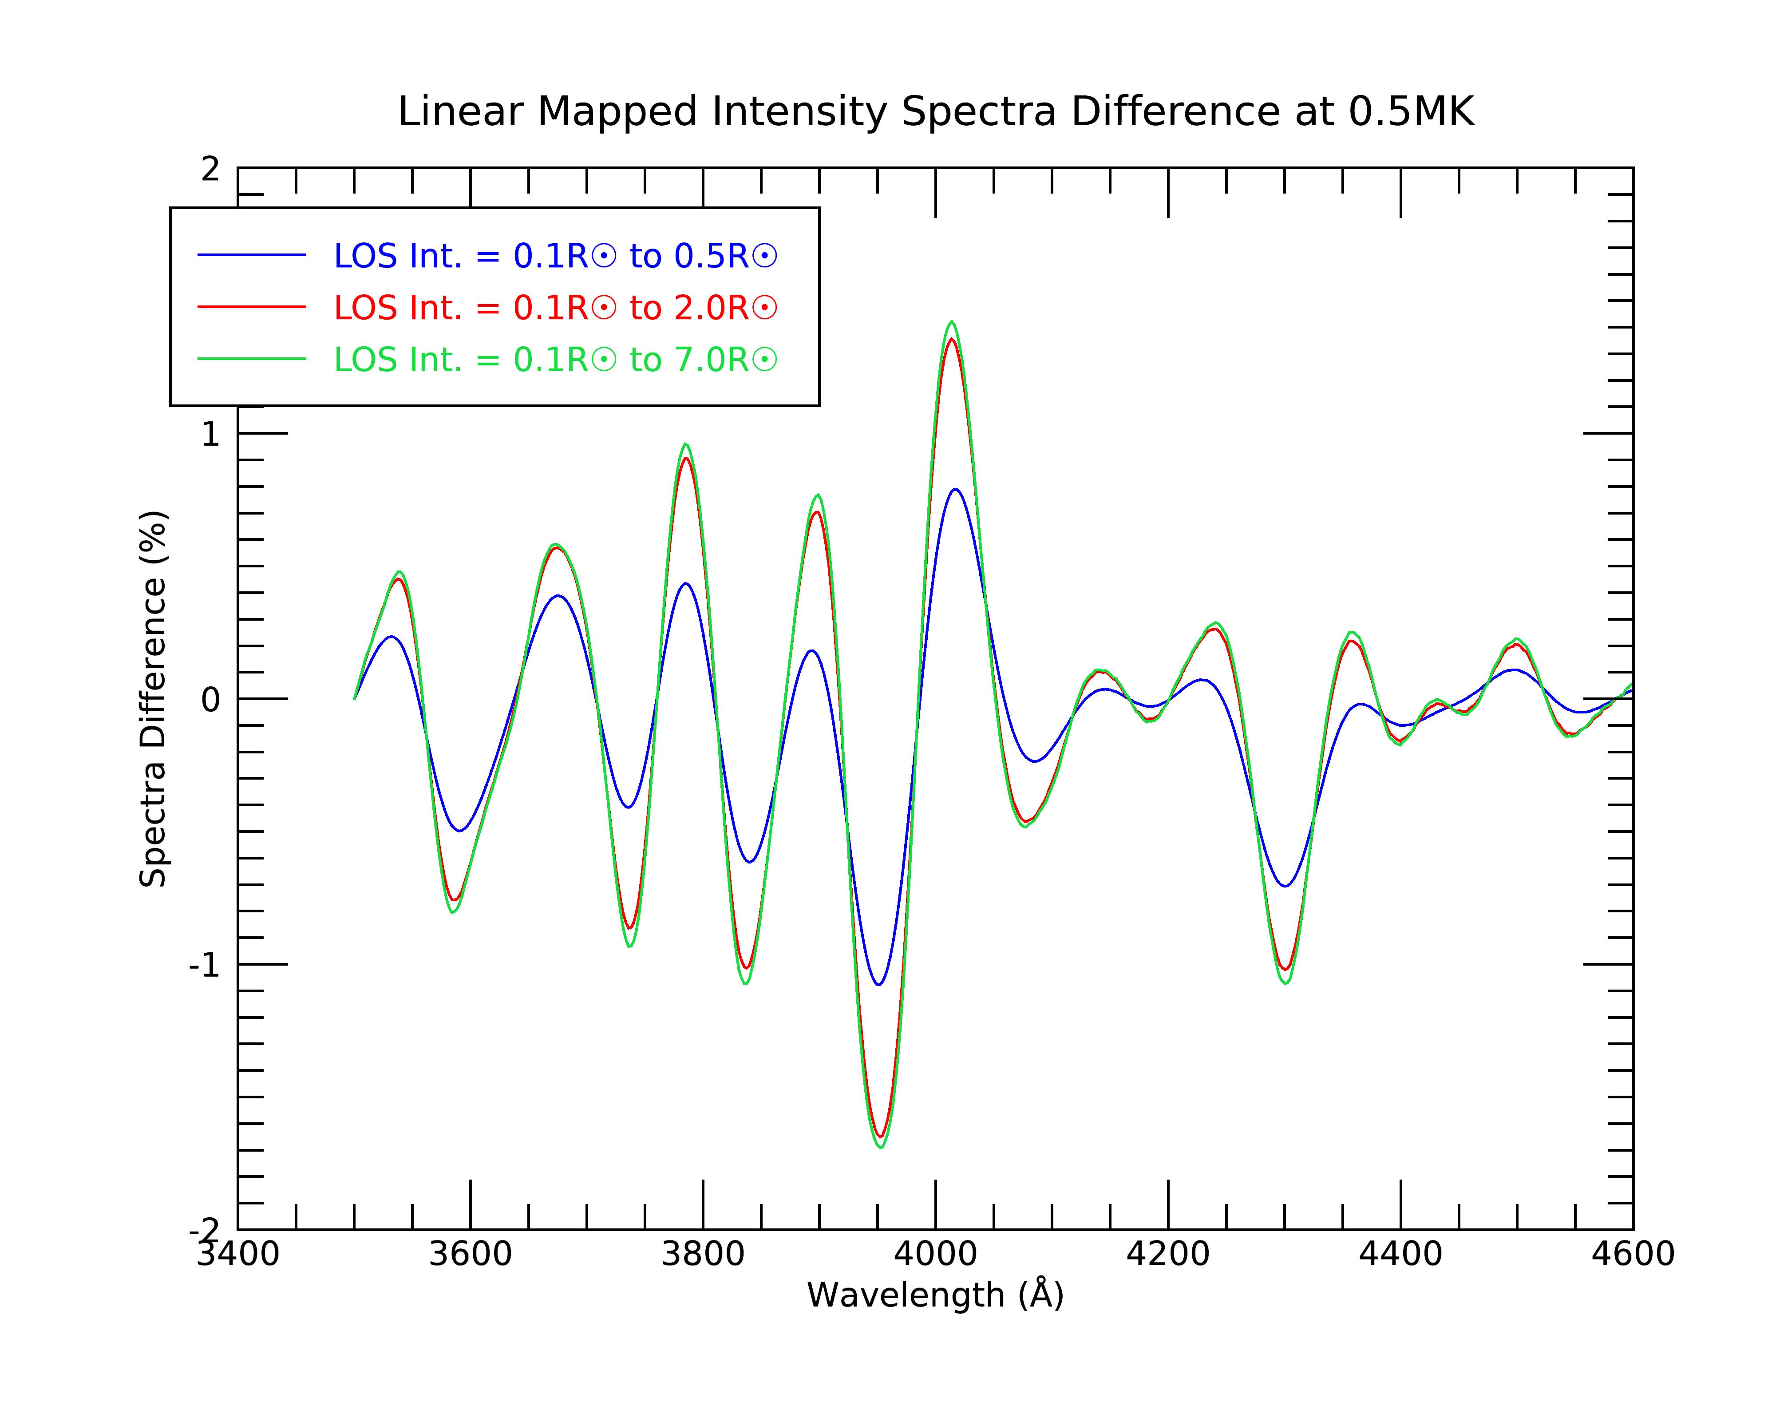
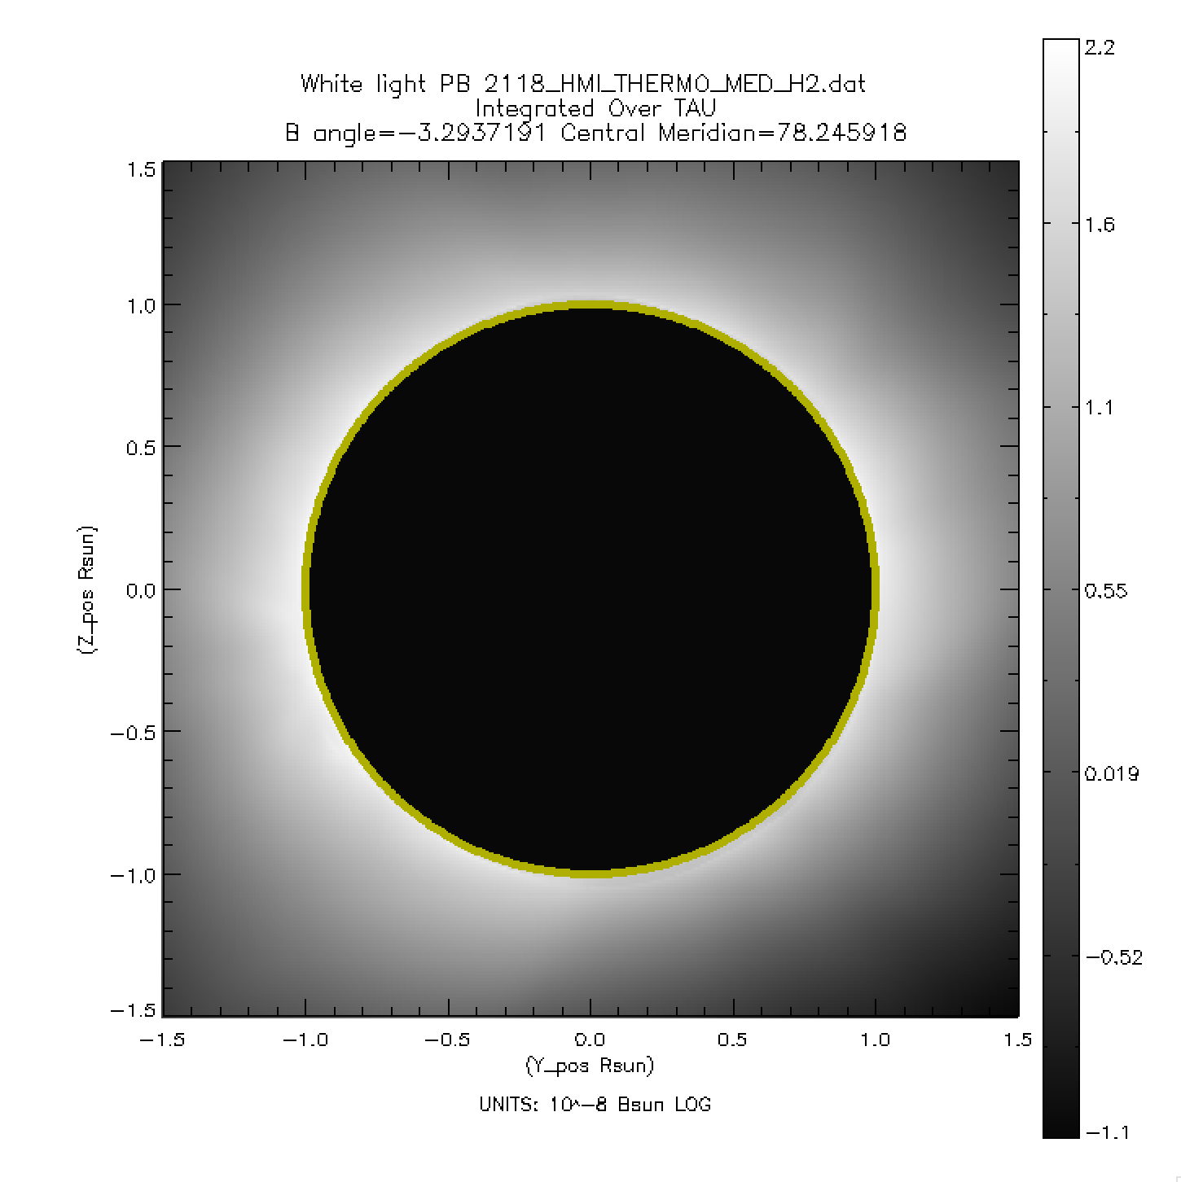
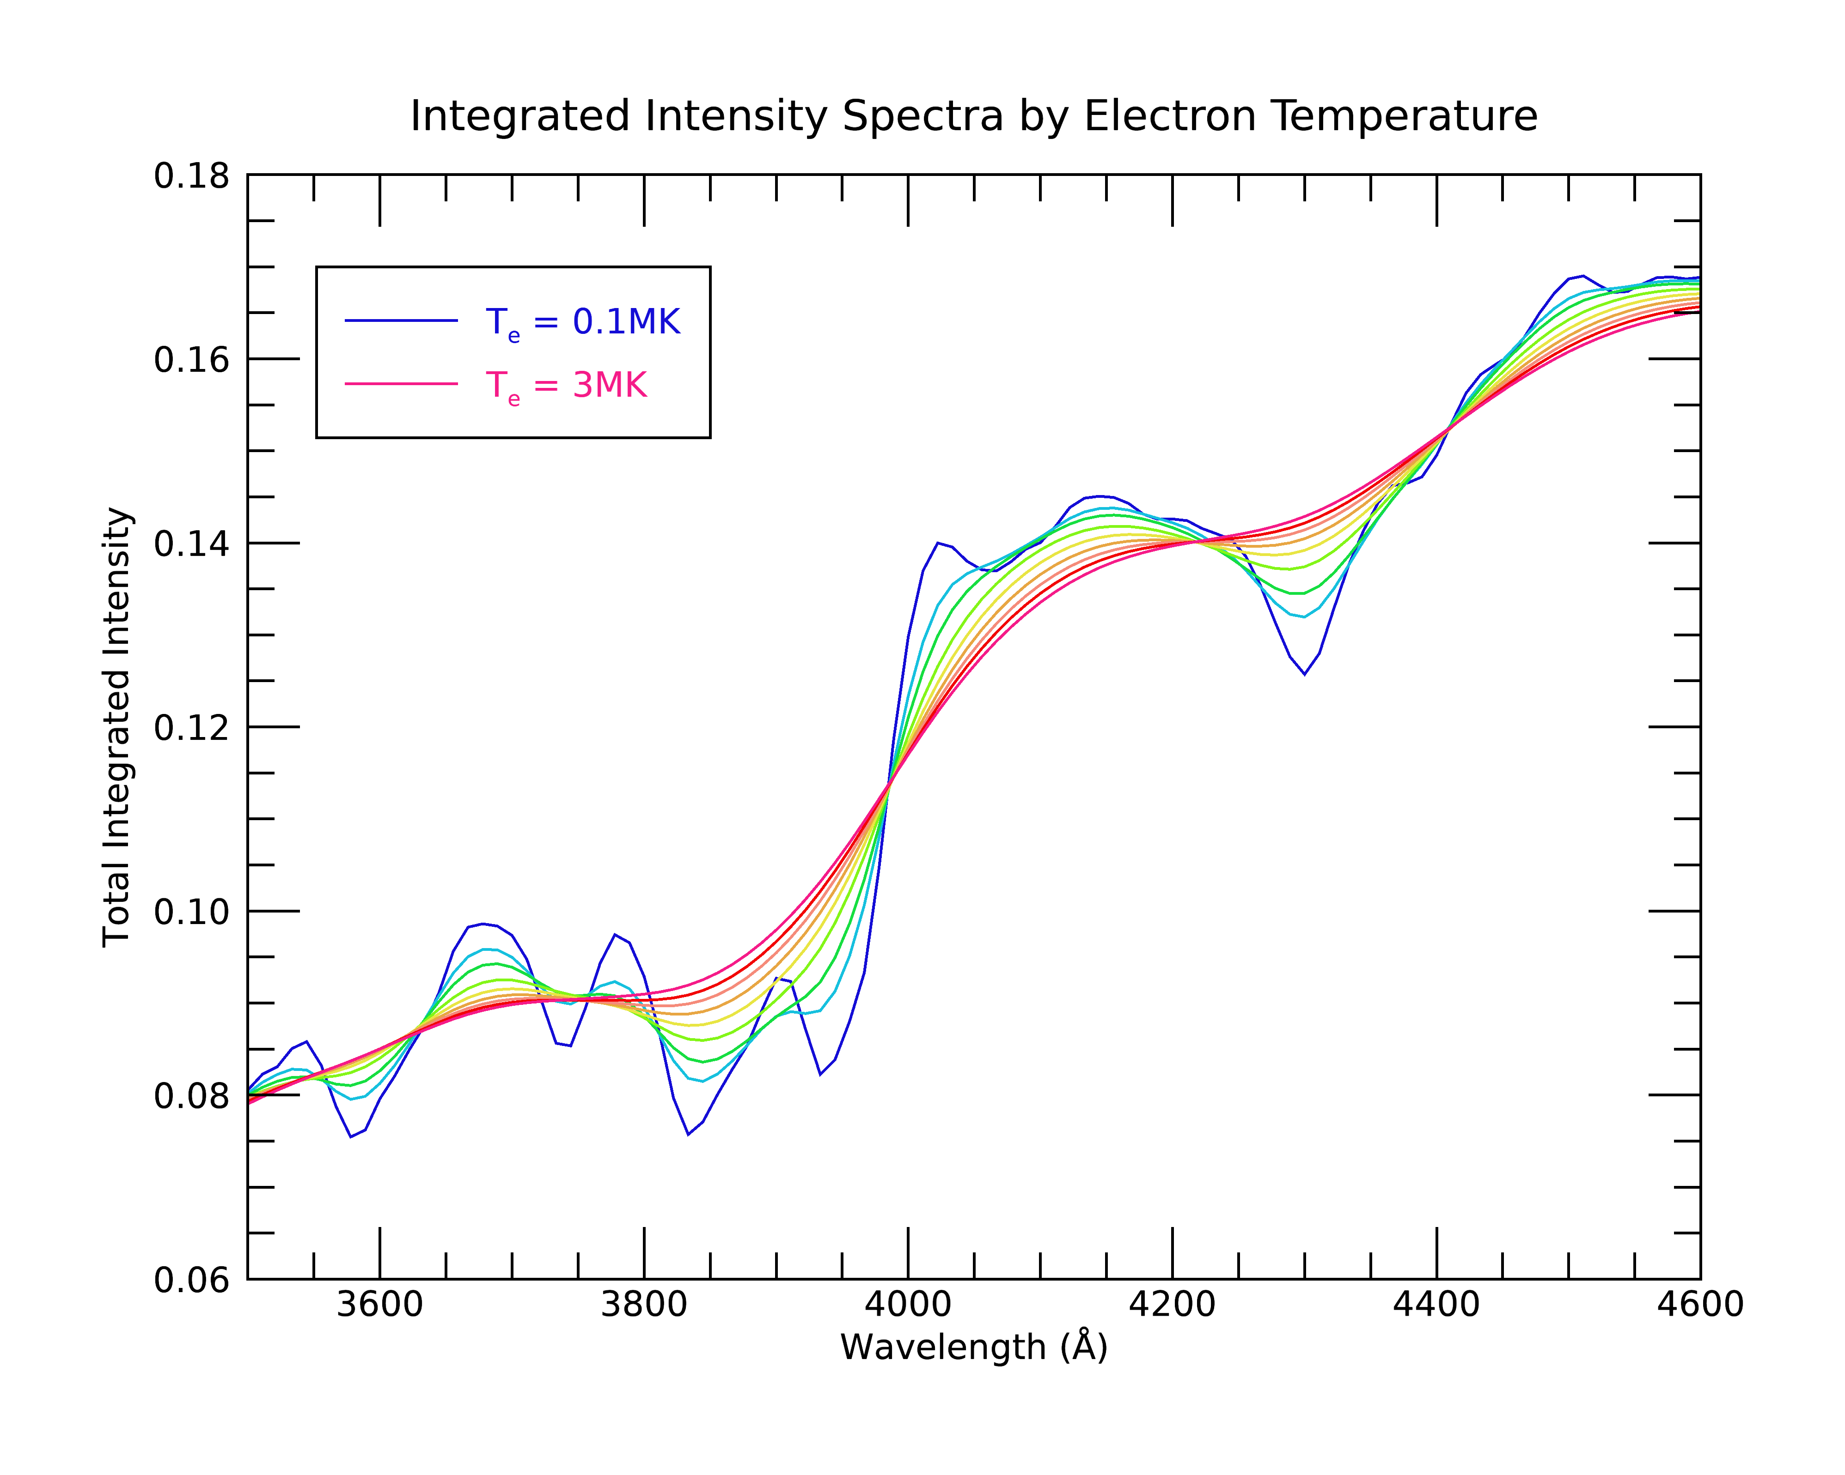
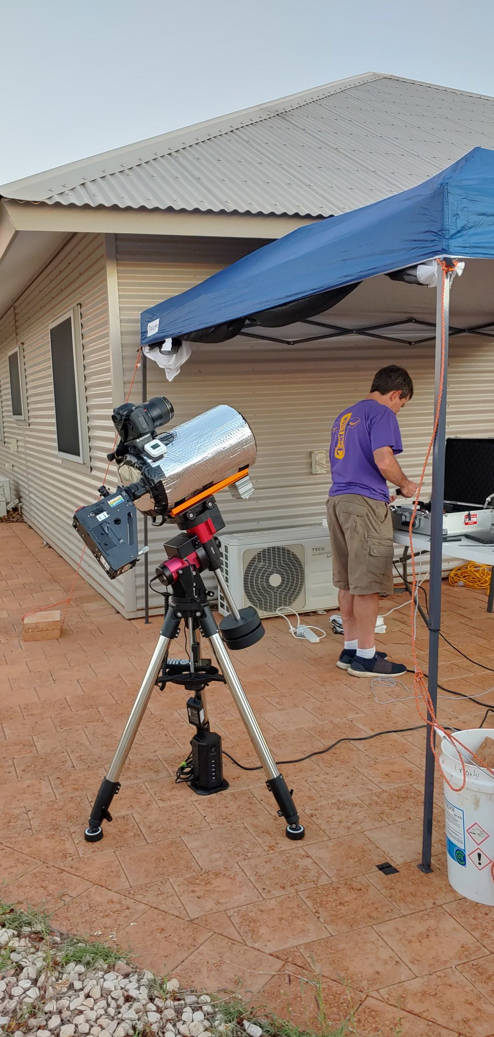
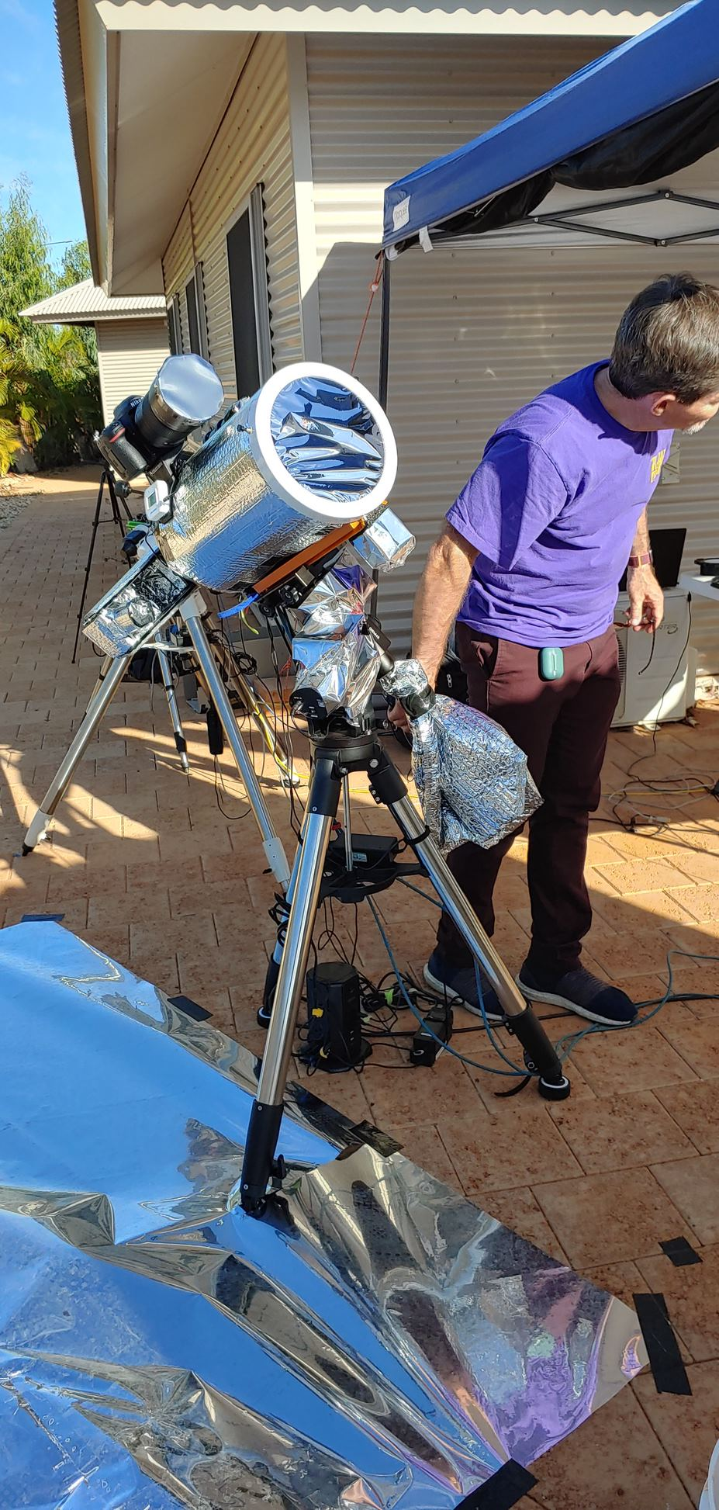
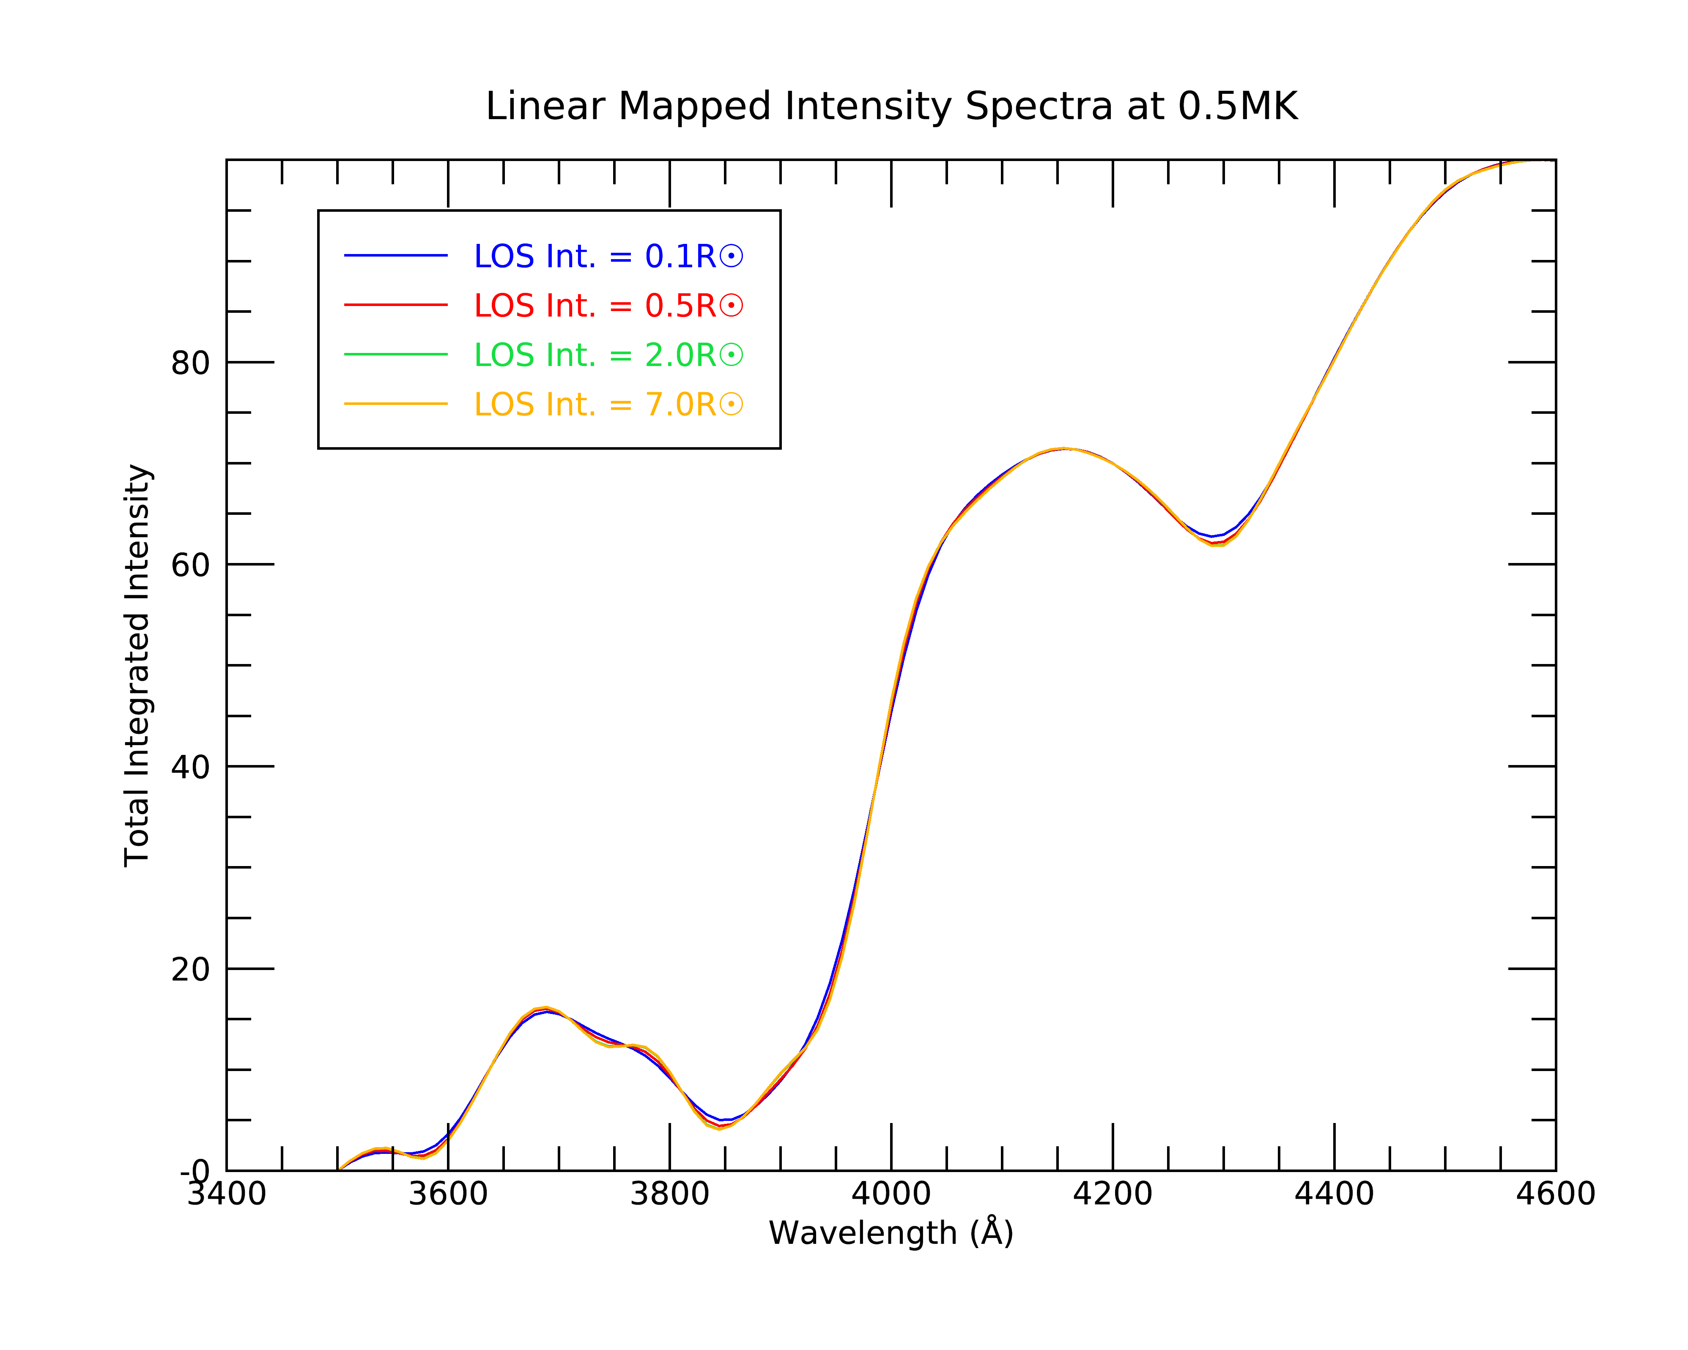
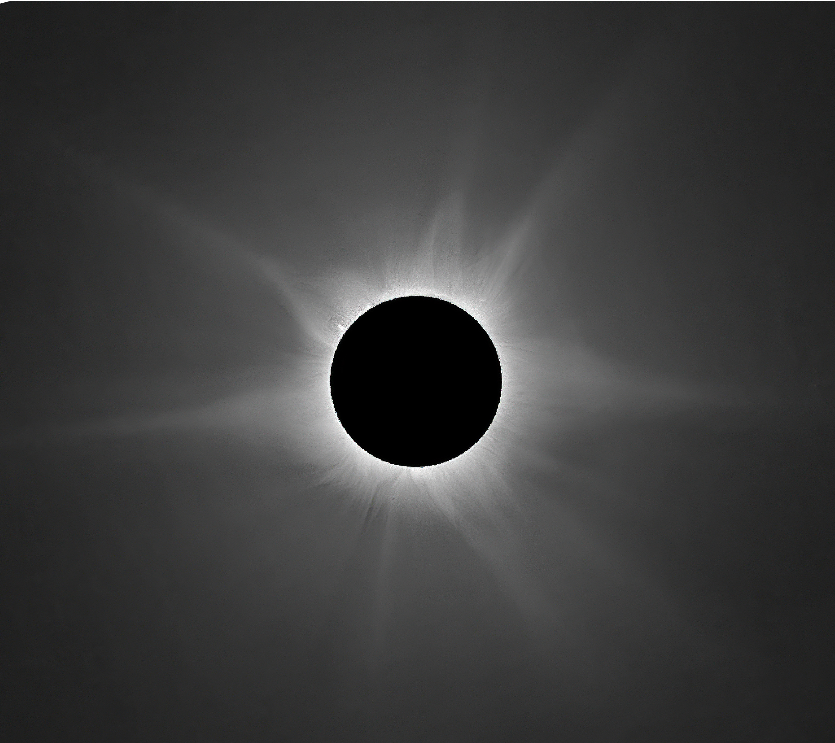
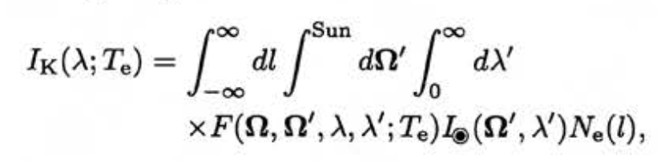
K-Corona Measurements at the 20 April 2023
Solar Eclipse
Sarah Bruce^{1,2}, Kevin Reardon^{1,2} ¹Department of Astrophysical and Planetary Sciences, University of Colorado Boulder, ²National Solar Observatory
Introduction
Spectra
Conclusion
During the 52-second total solar eclipse of 20 April, 2023 in Exmouth, Australia, we carried out several experiments aiming at investigating the low solar corona. We used a low dispersion (0.28 Å/pixel) slit spectrograph to obtain spectra covering the interval from 3600-4700 Å between 1-1.5 R☉). The scattering of the photospheric emission by the high-temperature, high-velocity coronal electrons smears out any Fraunhoffer lines but leaves broad spectral signatures that can be used to infer the magnitude of the broadening and hence the coronal electron temperature (Cram, 1976). Such measurements have been carried out a few times in the past (e.g. Ichimoto, et al., 1996; Reginald, 2009) and are the basis of the upcoming CODEX mission.
Experiment
FORWARD Modeling
For this experiment, we used a Shelyak Lhires III spectrograph attached to an 8” Celestron telescope, as well as a camera mounted on top of the telescope.
The setup was equipped with solar filters as well as reflective wrapping to avoid overheating the instruments. A reflective tarp was placed on the ground to minimize interference/noise due to heat waves emitting off the ground.
K-Coronal Temperatures
☹☺
References
Using solar irradiance … we calculate coronal spectra shapes at different temperatures integrated along the line of sight (LOS). By comparing spectra obtained at the eclipses, we can infer the electron temperature at our location in the corona. We calculate LOS integration using the equation:
where … is… yeah.
Cram, L. E. (1976), Determination of the temperature of the solar corona from the spectrum of the electron-scattering continuum, Sol. Phys., 48, 3–19.
Reginald, N. L., O. C. St.Cyr, J. M. Davila, D. M. Rabin, M. Guhathakuta, and D. M. Hassler(2009), Electron-temperature maps of the low solar corona: ISCORE results from the total solar eclipse of 29 March 2006 in Libya, Sol. Phys., 260, 347–361.
Ichimoto, K., K. Kumagai, I. Sano, T. Kobiki, T. Sakurai, and A. Munoz (1996), Measurement of the coronal electron temperature at the total solar eclipse on 1994 November 3, Pub. Astron. Soc. Jpn., 48, 545–554.
FORWARD uses … to simulate

